Slide 1






WEB FRAMEWORKS

Slide 2


Slide 3

INTRODUCTION
DEFINITION OF WEB FRAMEWORKS:
SOFTWARE LIBRARIES THAT SUPPORT WEB APPLICATION DEVELOPMENT.
PROVIDE A STRUCTURED FOUNDATION TO SIMPLIFY COMPLEX AND REPETITIVE TASKS.
ENABLE DEVELOPERS TO FOCUS ON UNIQUE APPLICATION FEATURES BY REUSING PRE-BUILT COMPONENTS.
IMPORTANCE OF WEB FRAMEWORKS:
EFFICIENCY AND SPEED
CONSISTENCY AND MAINTAINABILITY
SECURITY

Slide 4


OVERVIEW OF WEB TECHNOLOGIES
FLOW OF INTERACTION:
USER ACTION: A USER INTERACTS WITH THE CLIENT-SIDE INTERFACE (E.G., SUBMITS A FORM).
CLIENT-SIDE REQUEST: JAVASCRIPT CAPTURES THE USER ACTION AND SENDS A REQUEST TO THE SERVER USING AN API (RESTFUL API OR GRAPHQL).
SERVER-SIDE PROCESSING:THE SERVER-SIDE FRAMEWORK (NODE.JS/EXPRESS.JS, FLASK/DJANGO) RECEIVES THE REQUEST, PROCESSES IT (E.G., QUERYING THE DATABASE), AND PREPARES A RESPONSE.
RESPONSE TO CLIENT-SIDE:THE SERVER SENDS THE PROCESSED DATA BACK TO THE CLIENT-SIDE IN THE FORM OF A JSON RESPONSE.
CLIENT-SIDE UPDATE:JAVASCRIPT UPDATES THE USER INTERFACE BASED ON THE DATA RECEIVED FROM THE SERVER, PROVIDING THE USER WITH REAL-TIME FEEDBACK OR NEW CONTENT.

Slide 5
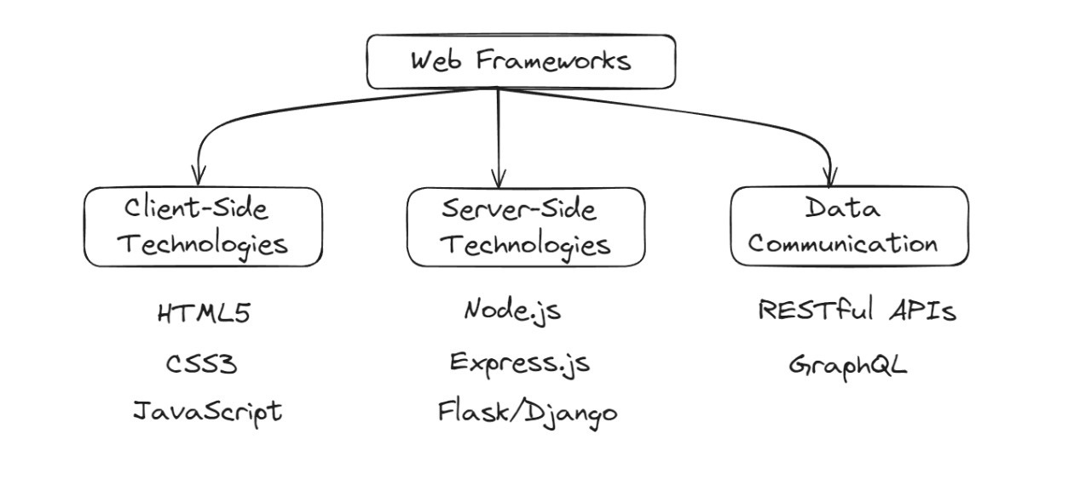
OVERVIEW OF WEB TECHNOLOGIES

Slide 6
ADVANTAGES OF WEB FRAMEWORKS
RAPID DEVELOPMENT: PRE-BUILT COMPONENTS REDUCE DEVELOPMENT TIME.
CONSISTENCY: ENFORCES BEST PRACTICES FOR MAINTAINABLE CODE.
SECURITY: BUILT-IN SECURITY FEATURES.
COMMUNITY AND ECOSYSTEM: ACCESS TO EXTENSIVE LIBRARIES AND ACTIVE COMMUNITIES.
SCALABILITY: SUPPORTS SCALABLE ARCHITECTURES.

Slide 7
DISADVANTAGES OF WEB FRAMEWORKS
LEARNING CURVE: TIME NEEDED TO LEARN FRAMEWORK-SPECIFIC PRACTICES.
Flexibility: Potential limitations on design choices.
Performance Overhead: Abstraction layers may introduce performance issues.
Compatibility and Updates: Challenges in keeping up with updates.
Resource Consumption: May consume more resources than custom-coded solutions.

Slide 8







OBJECTIVES
SIMPLIFY & ACCELERATE DEVELOPMENT
ENSURE CONSISTENCY & MAINTAINABILITY
ENHANCE PERFORMANCE & SCALABILITY
FACILITATE TESTING AND DEBUGGING
IMPROVE SECURITY

Slide 9


EXAMPLES

Slide 10






DJANGO
FEATURES:
Batteries Included: Built-in authentication, admin panel, ORM.
MVC Architecture: Follows the Model-View-Controller pattern.
Django REST Framework: Ideal for building RESTful APIs.
Security: security best practices.
BENEFITS:
DRAWBACKS:
Fast Development
Robust Security
Versatility
Strong Documentation
Monolithic structure
Complexity for small projects

Slide 11
EXPRESS.JS
FEATURES:
Minimalistic and flexible Node.js framework.
Middleware support.
Robust routing system.
Scalable for real-time apps.
BENEFITS:
DRAWBACKS:
High performance
Lightweight, suitable for microservices
Large and active community
Minimalistic: Requires additional libraries for complex apps.
Steep learning curve: Requires strong knowledge of Node.js and JavaScript.

Slide 12

THANK YOU!

